Slide 1
Person Re-Identification using Siamese Networks
Ronak Harish Bhanushali
Spring 2024
PRCV Final Project

Slide 2



Deep Learning for ReID - Siamese Net
Reference
Feature Extractor
300
800
Feature Extractor
L2 Norm
Yoda
Anakin
Feature Extractor
Candidates

Slide 3
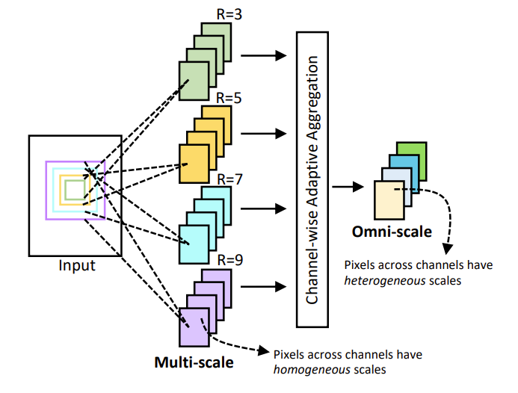
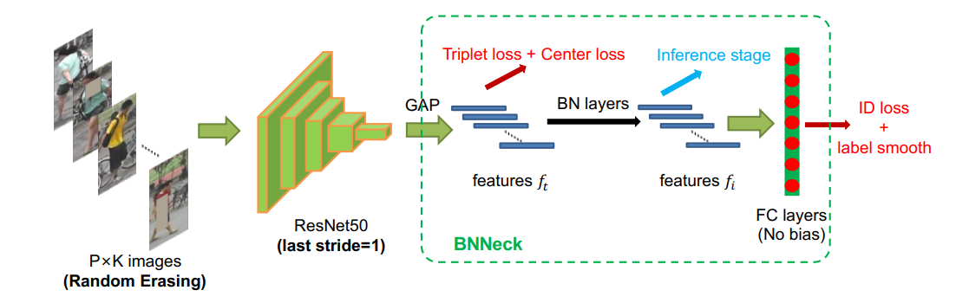
Model Architecture
ResNet50 or MobilenetV3Large

Slide 4
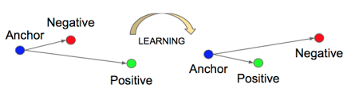
Training Loss - Triplet Loss
m=margin
If positive is closer to anchor than negative by the given margin,-
d(r_{a},r_{p}) +m < d(r_{a},r_{n})
i.e. Loss = 0
If positive is not closer to anchor than negative by the given margin,-
d(r_{a},r_{p}) +m > d(r_{a},r_{n})
i.e. Loss > 0

Slide 5
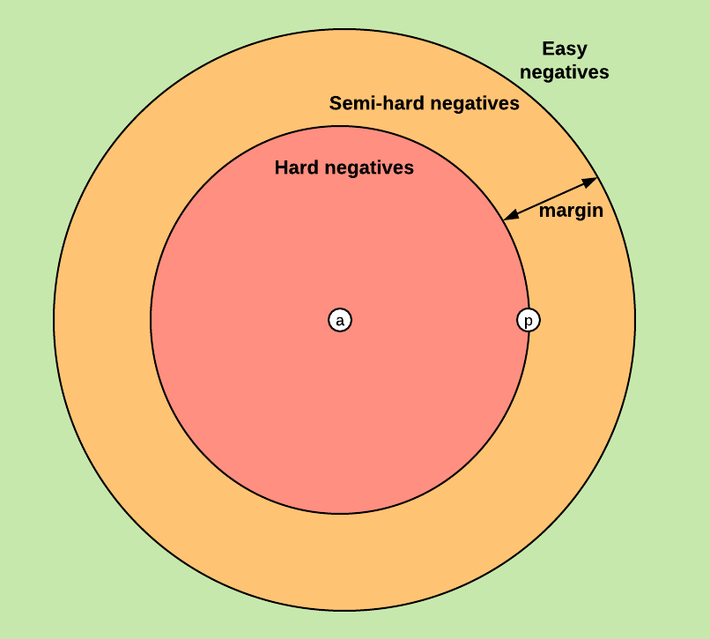
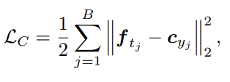

Center Loss + Label Smoothing + Hard Negatives
Center Loss
Penalizes model if feature vectors of same person look different
cyi is the class center for yth class
Label Smoothing for ID loss
ID loss is cross entropy loss
Label smoothing penalizes model for being too confident
Changes ground truth probability from 1 to 0.9 and distributes the remaining 0.1 among all classes
Hard Negatives
In a given batch of data, find the negatives which are very close to anchors to calculate loss

Slide 6
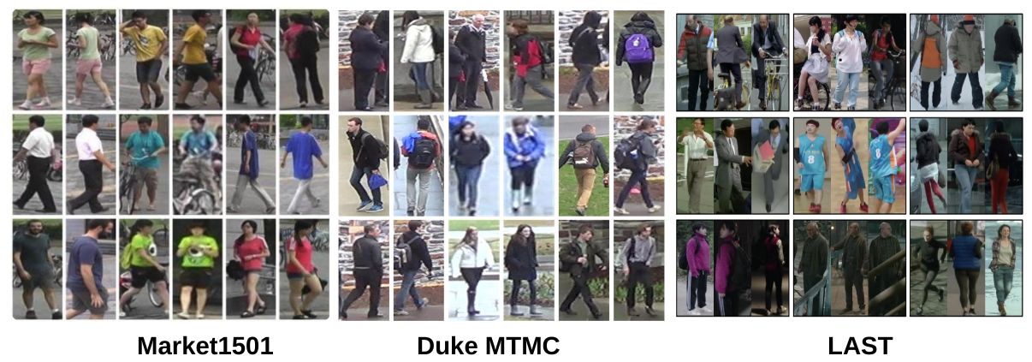

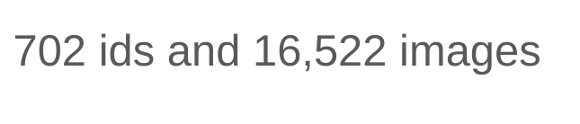

Training Datasets

Slide 7
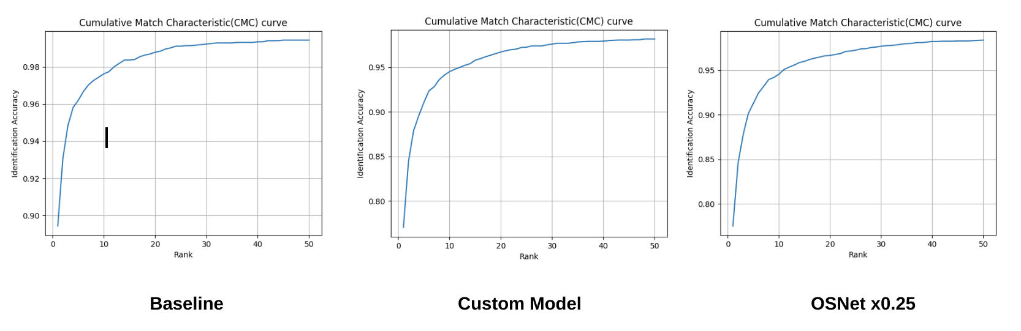
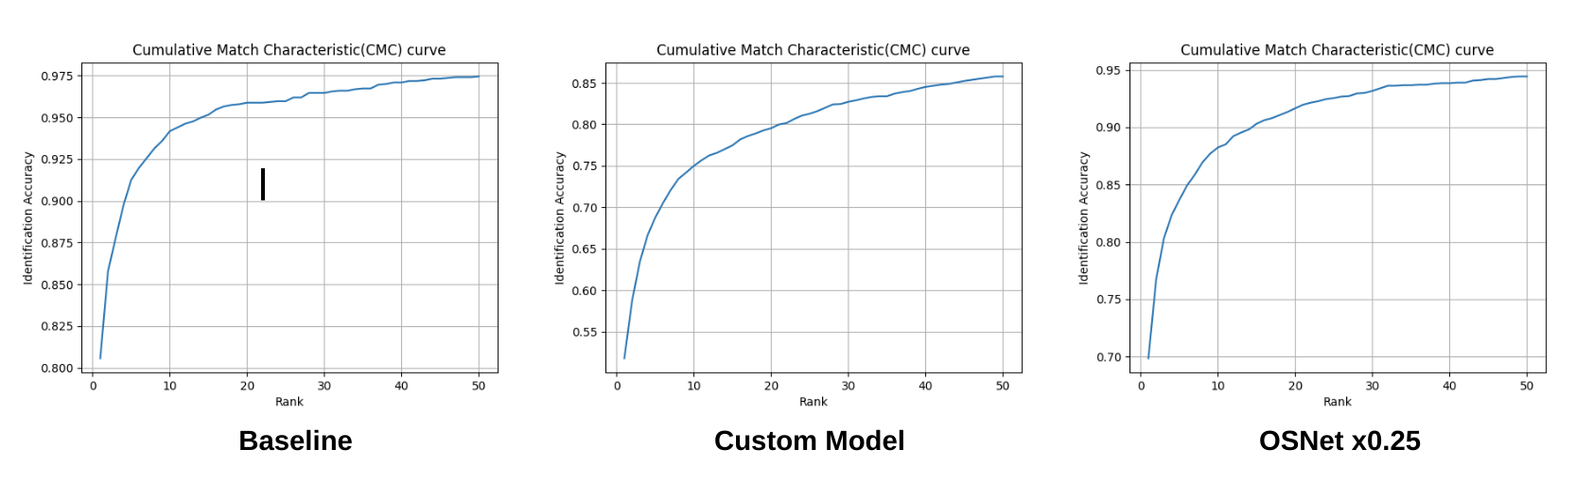
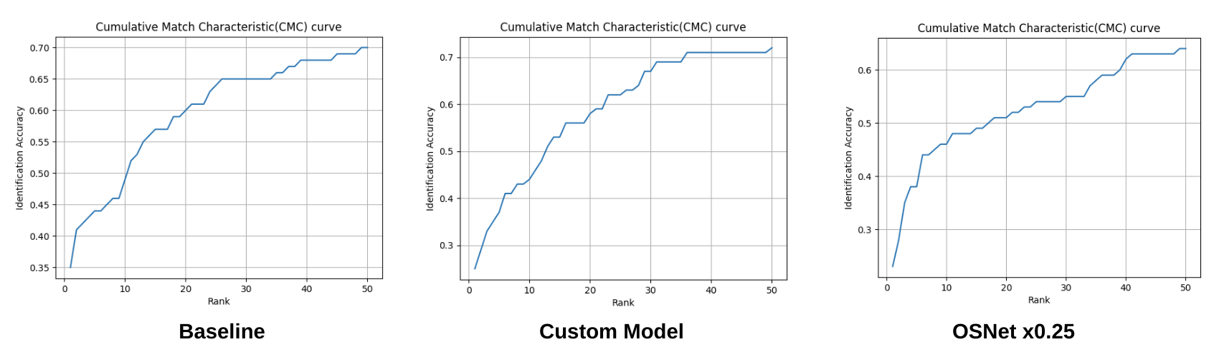
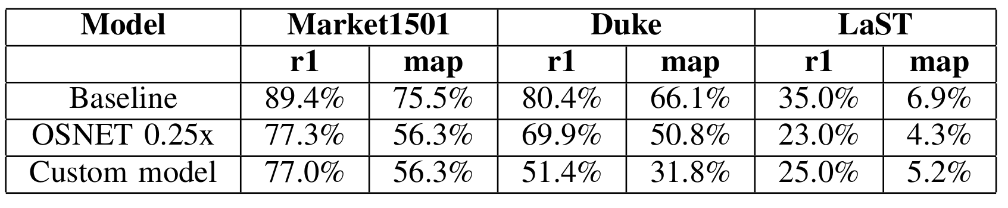
Results
Market1501
Duke MTMC
LaST

Slide 8
Conclusions
Suggested Baseline is a strong model that can be used if computation is ignored
OSNet performs neck to neck with the baseline and is the best overall pick considering low number of parameters
MobilenetV3 Large acts as a fair lightweight option but does not work well for the reID task
Different distance metrics were tried and most of them gave the same result. Since training was not done with the distance metrics, the experiment for different metrics was inconclusive
Transfer learning worked well between datasets and models were training quickly when fine tuning for a different dataset

Slide 9
Thank You!

